Slide 1
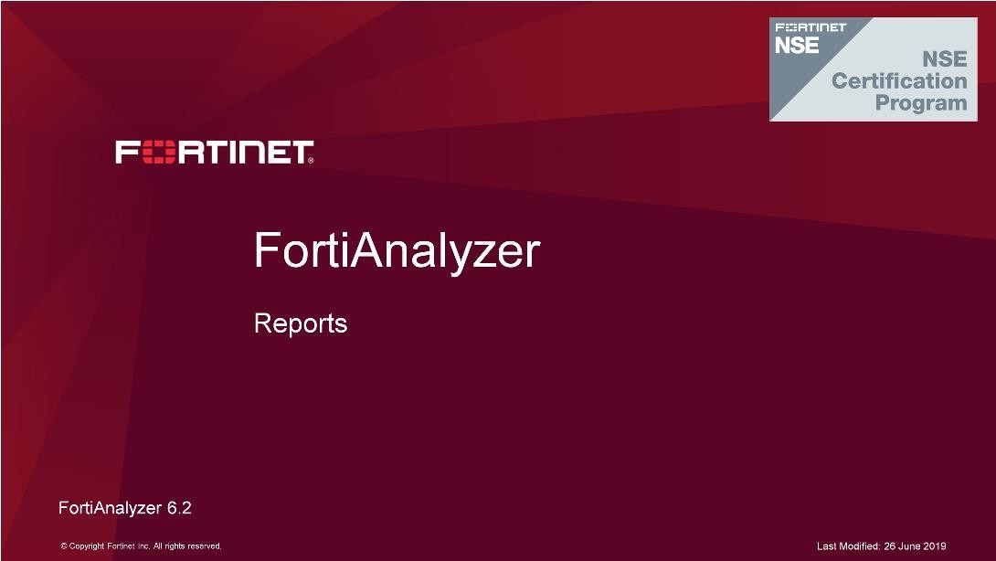
DO NOT REPRINT
© FORTINET
Reports
In this lesson, you will learn how to extract useful information from your logs for analysis purposes. To do this, you will learn to understand how data is formatted, stored, and organized in the database, and how to use the FortiAnalyzer reporting feature to view captured data for forensics and compliance.

Slide 2
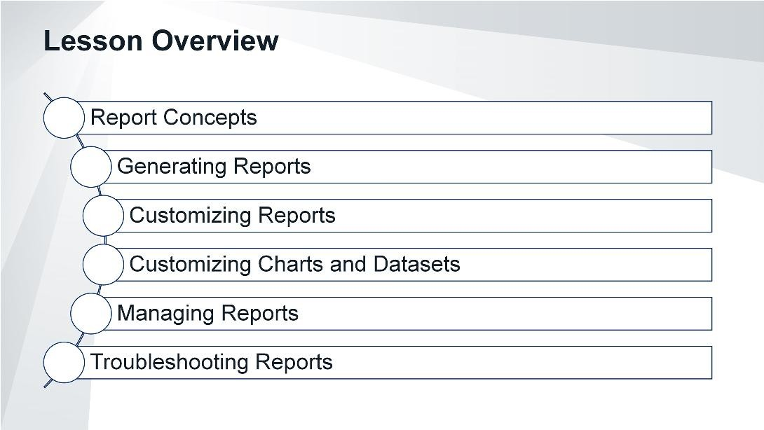
DO NOT REPRINT
© FORTINET
Reports
In this lesson, you will explore the topics shown on this slide.

Slide 3
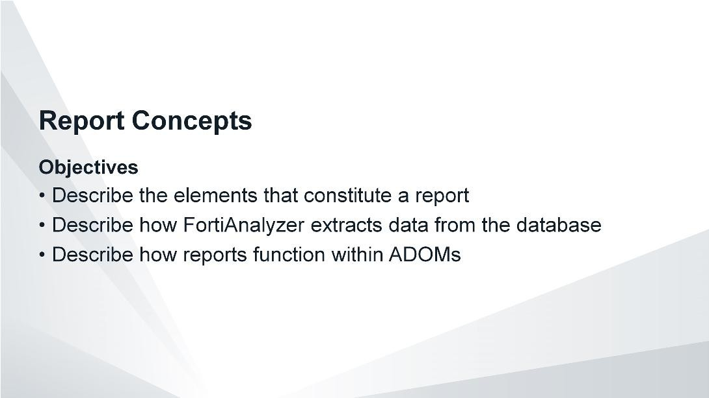
DO NOT REPRINT
© FORTINET
Reports
After completing this section, you should be able to achieve the objectives shown on this slide.
By demonstrating competence in understanding report concepts, you will be able to use reports to more effectively extract collected log data from your database.

Slide 4
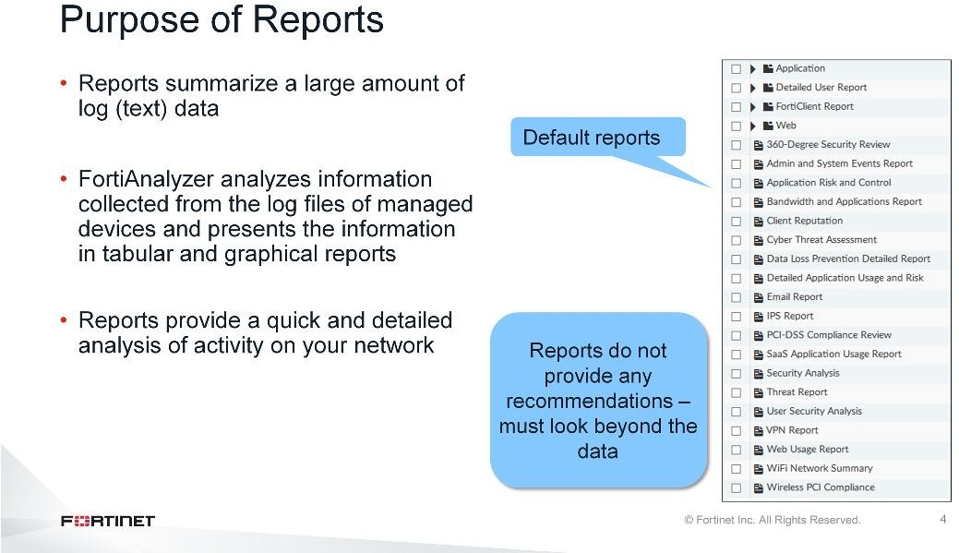
DO NOT REPRINT
© FORTINET
Reports
The purpose of a report is to summarize large amounts of logged data. Based on configured report parameters, FortiAnalyzer extracts data and presents it in a graphical manner that makes it easier—and quicker—to digest. The patterns and trends that reports reveal already exist as several points of data within your database, but it would be difficult and time consuming to manually locate, cross-reference, and analyze multiple log files, especially if you don’t know what trend or pattern you are looking for. Once configured, reports do the investigation for you and provide a quick and detailed analysis of activity on your network. You can then use that information to better understand your network or improve your network security.
Note that reports do not provide any recommendations or give any indication of problems. Administrators must be able to look beyond the data and charts to see what is happening within their network.

Slide 5
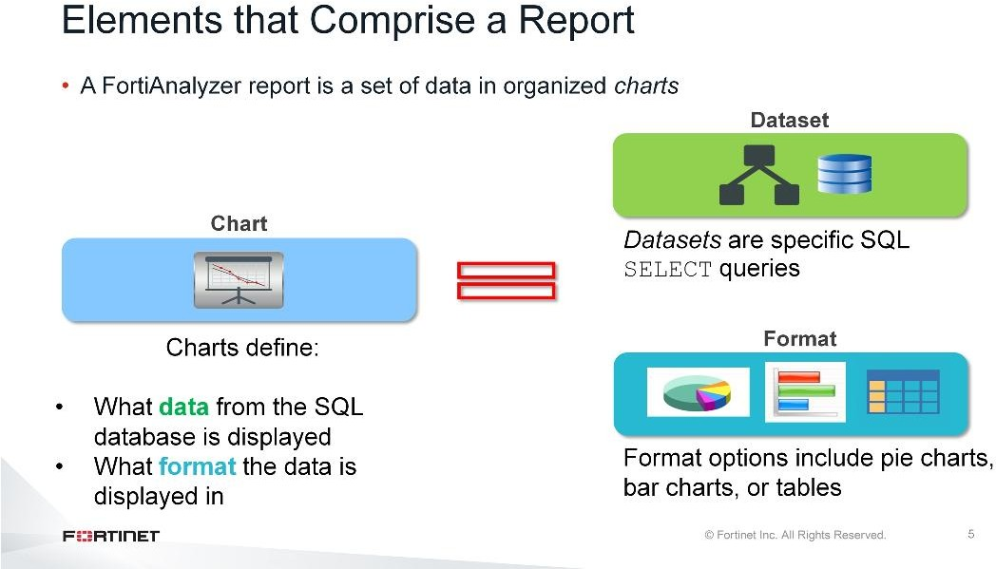
DO NOT REPRINT
© FORTINET
Reports
A FortiAnalyzer report is a set of data organized in charts. Charts consist of two elements:
Datasets, which are Structured Query Language (SQL)SELECTqueries that extract specific data from the database
The format in which to display that data (for example, pie charts, bar charts, or tables)

Slide 6
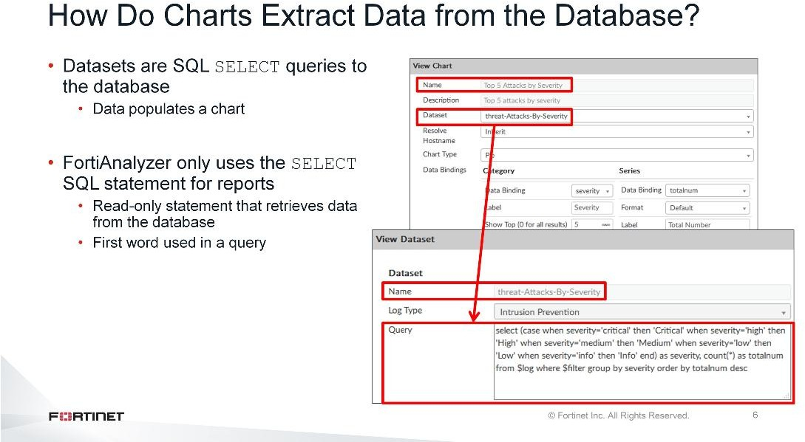
DO NOT REPRINT
© FORTINET
Reports
In order to populate a chart with specific log data that has been collected, stored, and sorted in the SQL database, it relies on a dataset query to extract that log data. A dataset is a specific SQLSELECTquery—a read-only statement that retrieves data from the database.
TheSELECTstatement is the first word used in a query—it is the declarative verb describing what you want done.

Slide 7
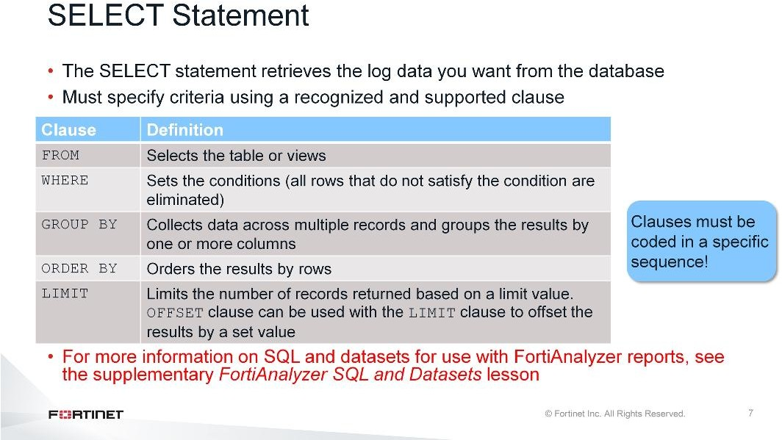
DO NOT REPRINT
© FORTINET
Reports
To extract the data you want from the SQL database, you must therefore specify the criteria. In order to put this criteria into a language that SQL understands, you must use a clause recognized by theSELECT statement.
The main clauses FortiAnalyzer reports use are as follows:
FROM, which specifies the table
WHERE, which specifies the conditions. All rows that don’t satisfy the condition are eliminated from the
output.
GROUP BY, which collects data across multiple records and groups the results by one or more columns
ORDER BY, which orders the results by rows. IfORDER BYis not given, the rows are returned in whatever
order the system finds the fastest to produce.
LIMIT, which limits the number of records returned based on a specified value.OFFSETis another clause often used along withLIMIT, which offset results by the number specified. For example, if you place a limit
of three records and an offset of one, the first record that would normally be returned is skipped and instead the second, third, and fourth records (three in total) are returned.
FROMis the only mandatory clause required to form aSELECTstatement; the rest of the clauses are optional and serve to filter or limit, aggregate or combine, and control the sort. It is also important to note that the clauses must be coded in a specific sequence. Accordingly, following theSELECTkeyword, the statement must be followed by one or more clauses in the order in which they appear in the table shown on this slide. For example, you can’t use theWHEREclause before theFROMclause. You don’t have to use all optional clauses, but whichever ones you do use must be in the correct sequence.
For more information on SQL and datasets for use with FortiAnalyzer reports, see the supplementary
FortiAnalyzer SQL and Datasetslesson.

Slide 8
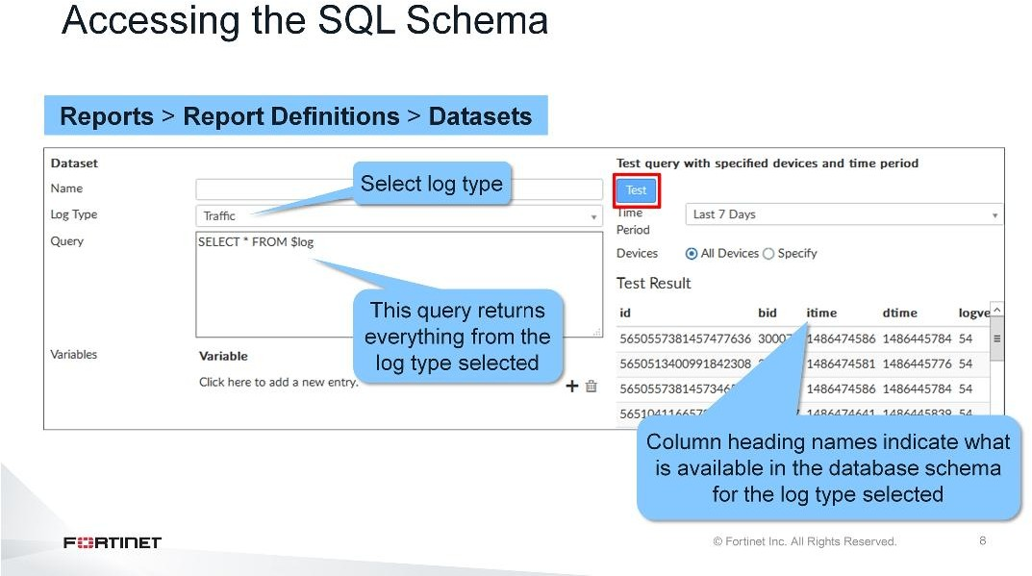
DO NOT REPRINT
© FORTINET
Reports
In order to create a query, you first need to know what is included in the database schema—you need to know what information is available to extract for reports. In FortiAnalyzer, you can obtain the schema for a specific log type by creating and testing the following dataset query:
SELECT * FROM $log
For traffic logs, for example, associate theTrafficlog type with this dataset in theLog Typedrop-down list.
This query returns everything from the traffic log type. The column heading names indicate what is available in the database schema for the log type selected. The * symbol is used as a way to return all data.

Slide 9
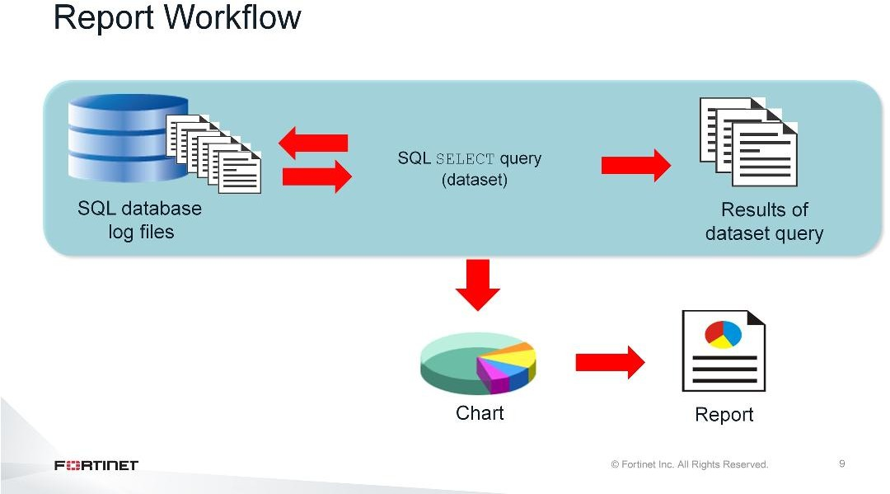
DO NOT REPRINT
© FORTINET
Reports
As the graphic on this slide shows, the SQL database contains all the raw logs. An SQLSELECTquery polls the database for specific information. Based on the query, a subset of information stored in the logs is extracted.
This subset of data populates a chart and one or more charts exist within a report.

Slide 10
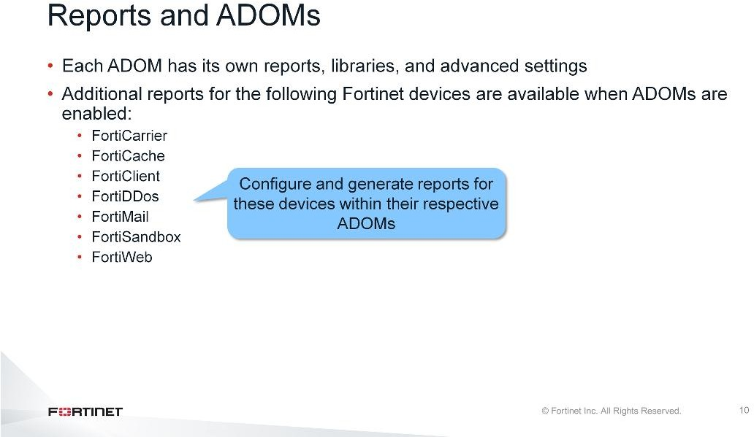
DO NOT REPRINT
© FORTINET
Reports
When ADOMs are enabled, each ADOM has its own reports, libraries, and advanced settings. As such, make sure that you are in the correct ADOM before selecting a report.
Additional reports for specific Fortinet devices are available only when ADOMs are enabled. You can configure and generate reports for these devices within their respective ADOMs. These devices also have device-specific charts and datasets.

Slide 11
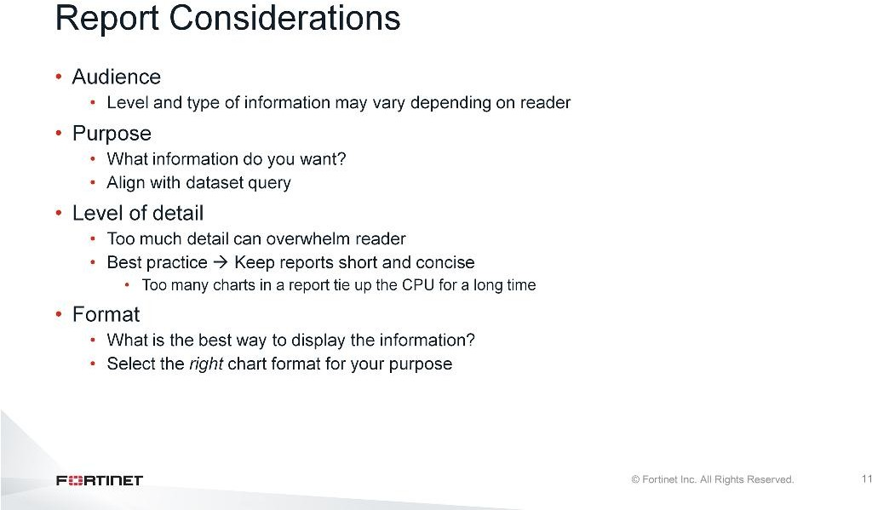
DO NOT REPRINT
© FORTINET
Reports
Before you configure or create a report, there are certain factors you need to consider to ensure the report is as effective as possible.
The first consideration is your audience. Who’s going to be looking at this report? Depending on what they want to see and their level of skill, you may need to add, remove, or modify charts in order to convey the information appropriately.
The second consideration is your purpose. If you look at the predefined reports, each one focuses on a specific piece of information. They are based on specific datasets and contain charts that format that query. So, reports must be focused in order to be effective and easily digestible, and this is achieved by having a strong purpose.
The next consideration is the level of detail. Best practice is to keep reports short and concise. Not only will it focus your view of your network and users, but shorter reports have fewer charts and fewer queries to run.
This helps with performance, as large reports affect CPU and memory.
The final consideration is the format. You need to know how you want to format the data so that it displays in the most digestible and informative way possible. A table chart, bar chart, and pie chart don’t necessarily represent the same data with the same effectiveness. Based on your query, you may only be able to use one type of chart, but if options are available, you need to select the right chart. Think about how the data would best be represented visually, and about the audience consuming the data. Aside from the chart format, you can also change the design of the report by adding separators, page breaks, images, and renaming charts.

Slide 12
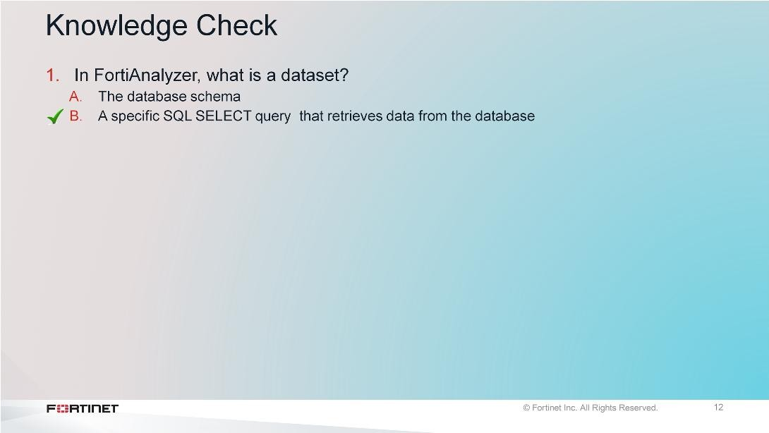
DO NOT REPRINT
© FORTINET
Reports

Slide 13
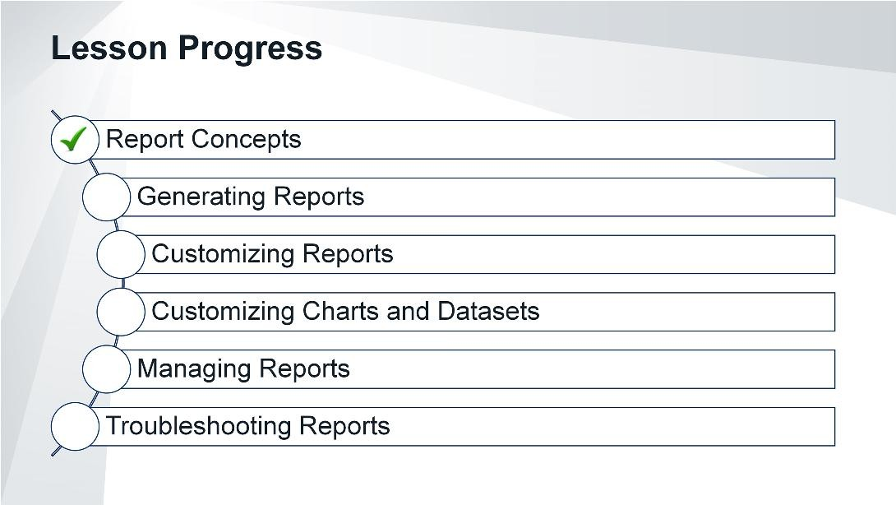
DO NOT REPRINT
© FORTINET
Reports
Good job! You now understand report concepts.
Now, you will learn how to generate reports in FortiAnalyzer.

Slide 14
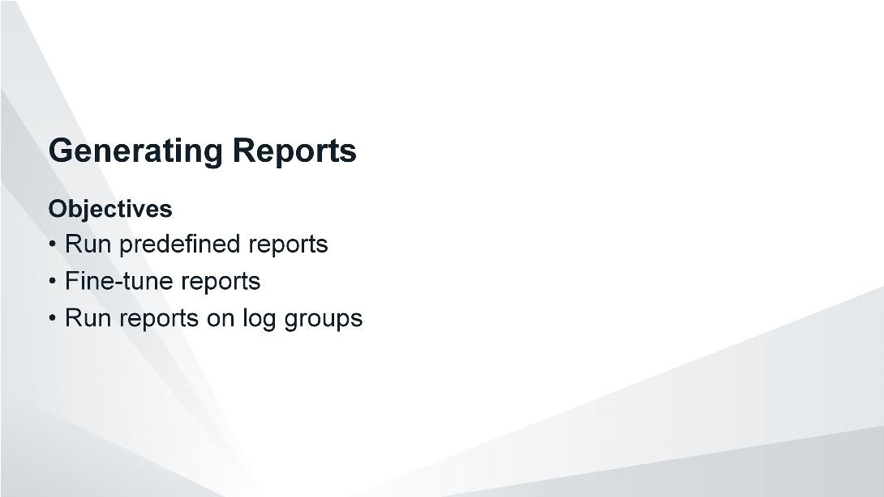
DO NOT REPRINT
© FORTINET
Reports
After completing this section, you should be able to achieve the objectives shown on the slide.
By demonstrating competence in report generation, you will be able to quickly view a detailed analysis of activity on your network in a way that is consumable.

Slide 15
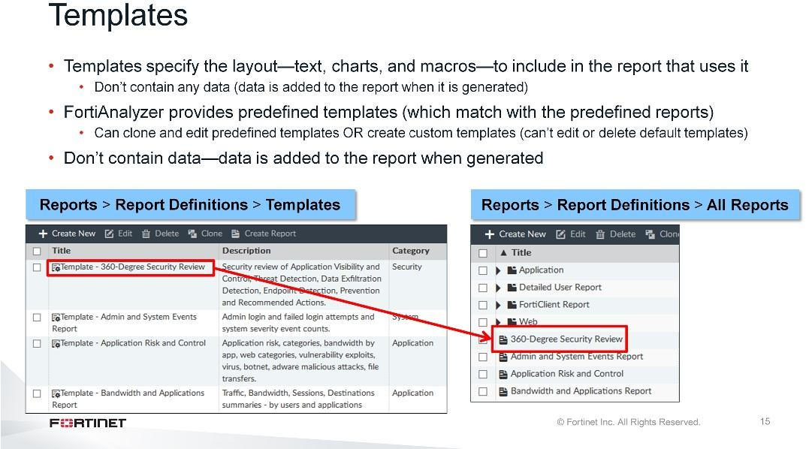
DO NOT REPRINT
© FORTINET
Reports
FortiAnalyzer provides predefined templates for reports. Templates specify the layout—texts, charts, and macros—to include in the report that uses it. By default, these predefined templates are associated with their respective predefined reports. For example, theTemplate – 360-Degree Security Reviewtemplate is the template used by the predefined360-degree Security Reviewreport.
Templates don’t contain any data. Data is added to the report when you generate it.
You can’t edit a predefined template, but you can clone and edit it to fit your requirements. You can also create your own template from scratch.

Slide 16
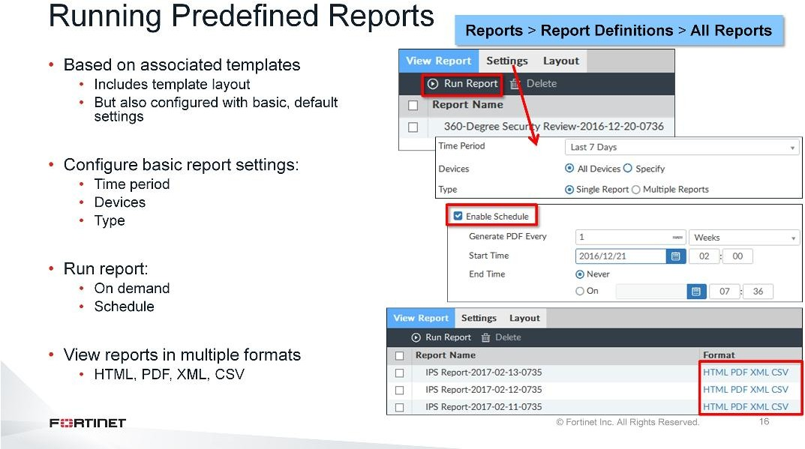
DO NOT REPRINT
© FORTINET
Reports
FortiAnalyzer also provides predefined reports—each one associated with a predefined template (the layout). Predefined reports come with basic, default settings already configured. These basic settings define the time period in which to run the report; what device, or devices, to run the report on; and whether the report generates as a single report or multiple reports.
As such, you can run the predefined reportsas is, but at minimum you should examine, and adjust if necessary, the basic default setting configurations. For example, if today is the first day FortiAnalyzer has been collecting logs, your report will contain no data if the time period is set toLast 7 Days. Last <n> days is handled differently in FortiView then reports. In reports, it does not include the current day.
You can run reports on demand, or schedule them for a specific time by enabling scheduling.
After it is generated, the report is available to view in multiple formats, including HTML, PDF, XML, and CSV.

Slide 17
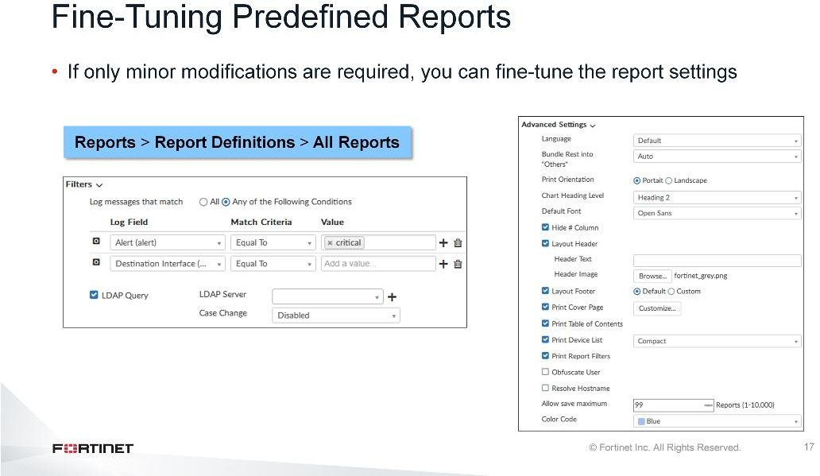
DO NOT REPRINT
© FORTINET
Reports
If a predefined report comes extremely close to meeting all your requirements, but not quite, you may be able to fine-tune the report using the report settings. Fine-tuning encompasses minimal report modifications, such as:
Adding log message filters to further refine the log data that is included in the report
Enabling queries to a pre-existing LDAP server to add an LDAP query to the report
Configuring report language, print settings, and other settings. For example, you can print and customize the cover page, print the table of contents, print a device list, obfuscate users, and set the color code for the report to appear underReport Calendar.

Slide 18
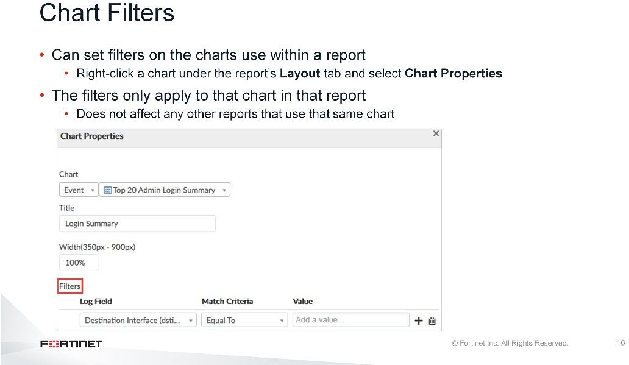
DO NOT REPRINT
© FORTINET
Reports
We just discussed setting filters at the report level in the report settings. However, you can also set filters on the charts used within the report.
Within the report’sLayouttab, right-click the chart and selectChart Properties. The filters you set here only apply to that chart in that report. As such, it will not affect any other reports that use that same chart.

Slide 19
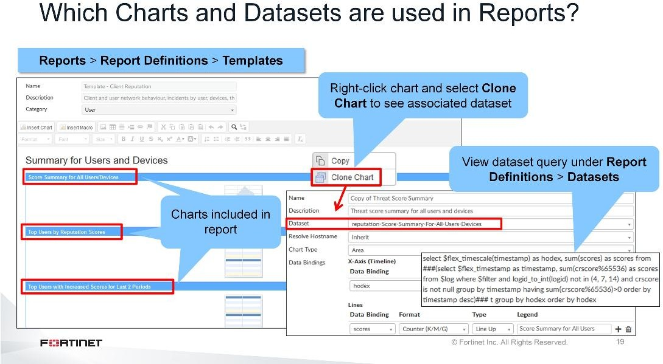
DO NOT REPRINT
© FORTINET
Reports
While the name of predefined reports aims to be indicative of what type of data is included in the report, having a more complete view of the report contents is helpful—especially when trying to determine if a predefined report meets your needs. One way is to examine what charts are contained in the report, and on a more granular level, what datasets define those charts.
There are several ways to determine which charts and datasets are used in reports. One quick way is to view the template associated with the report. The template includes all the charts included in the report. To discover which dataset is associated with a chart, right-click the chart and selectClone Chart. The dialog that appears lists the dataset.
You can view the specific query for the dataset on theDatasetspage.

Slide 20
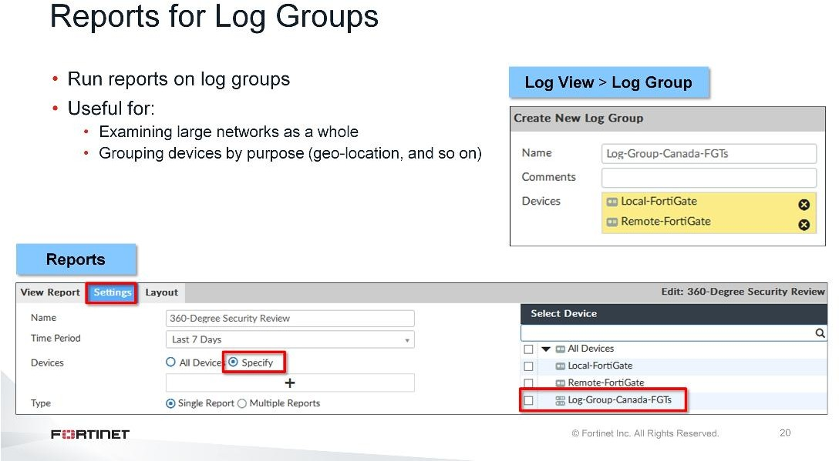
DO NOT REPRINT
© FORTINET
Reports
FortiAnalyzer also provides the ability to run reports on log groups so you can look at the log data from the group as if it were a single device.
One such use case for log groups is to determine how your network is performing as a whole, especially if you have a large network that has multiple FortiGates positioned at different points. You can obtain information about total traffic usage and get a complete picture of your network instead of receiving a fragmented look based on multiple, unconnected devices.
You may want to use log groups to determine how devices in specific geographical locations are performing as well.

Slide 21
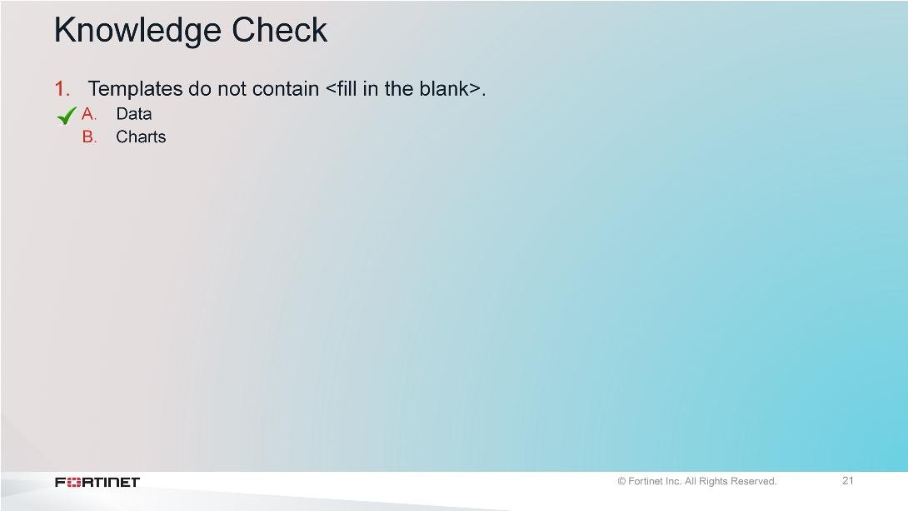
DO NOT REPRINT
© FORTINET
Reports

Slide 22
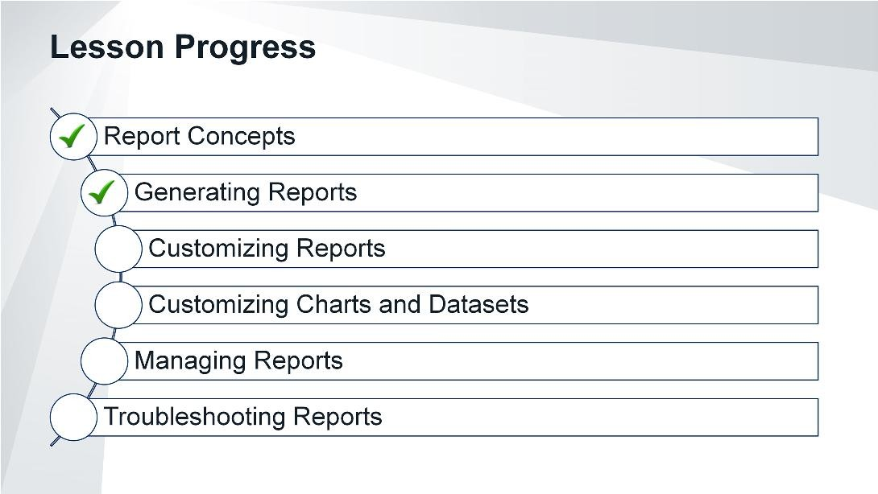
DO NOT REPRINT
© FORTINET
Reports
Good job! You now understand how to generate reports.
Now, you will learn how to customize reports.

Slide 23
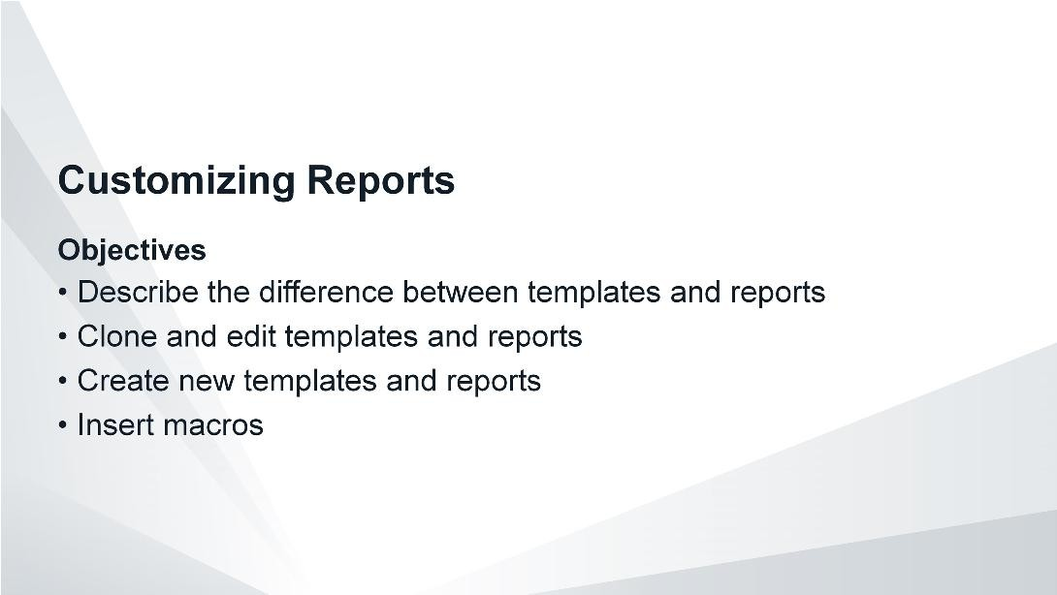
DO NOT REPRINT
© FORTINET
Reports
After completing this section, you should be able to achieve the objectives shown on this slide.
By demonstrating competence in report customization, you will be able to generate reports specific to your requirements.

Slide 24
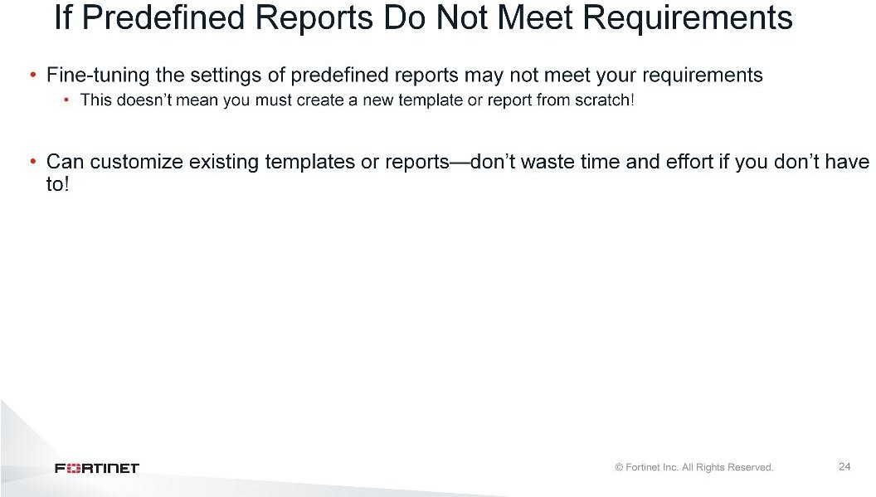
DO NOT REPRINT
© FORTINET
Reports
Predefined reports may not meet all of your organization’s requirements, even after fine-tuning the report settings. While FortiAnalyzer provides the option to create new templates and reports from scratch, there are customization options available.

Slide 25
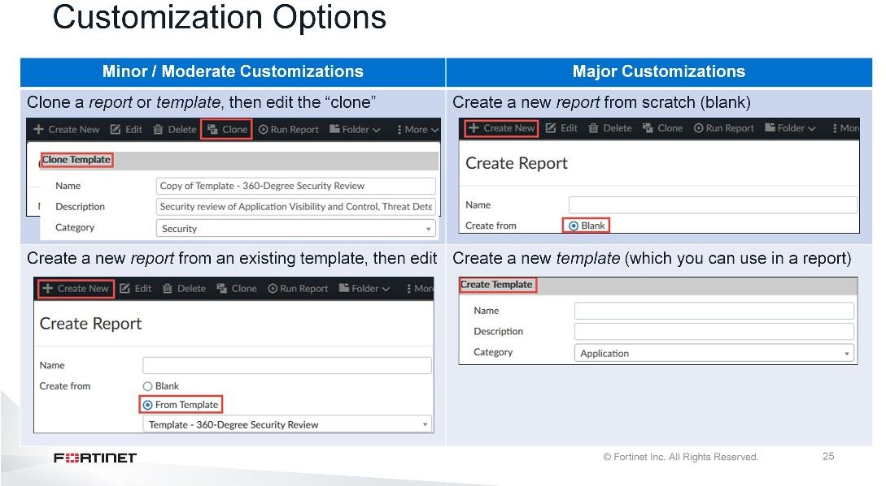
DO NOT REPRINT
© FORTINET
Reports
For example, for minor or moderate changes to existing templates or reports, you can use cloning. For cloning, you would clone a report or template and then edit thecloneto suit your requirements. For reports only, you can create a new report, but base it off an existing template. Then edit that new report to suit your requirements.
While you can directly edit the layout of predefined reports (but not templates), it is best practice to clone and edit predefined reports instead. This preserves the default reports if your direct edits to the report are not successful.
If major changes are required to existing templates or reports (that is, no report meets your needs), you can create a new report or template from scratch.

Slide 26
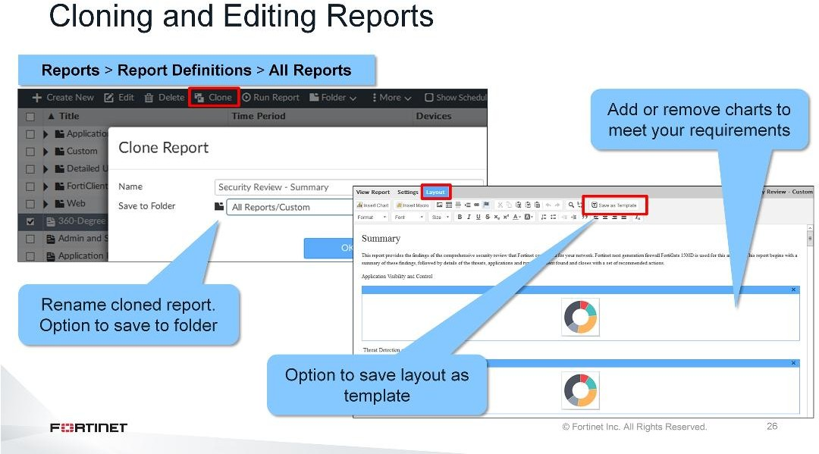
DO NOT REPRINT
© FORTINET
Reports
You can clone a report from theAll Reportspage. Again, you should clone when you need to make only
minor to moderate changes. For example, when you want to borrow many of the elements, but not all, from an existing report. In the cloned report, you can edit the settings as well as the layout. Note that theLayouttab provides the option to save the layout as a template, if necessary.
Unlike predefined reports, you can delete cloned reports.

Slide 27
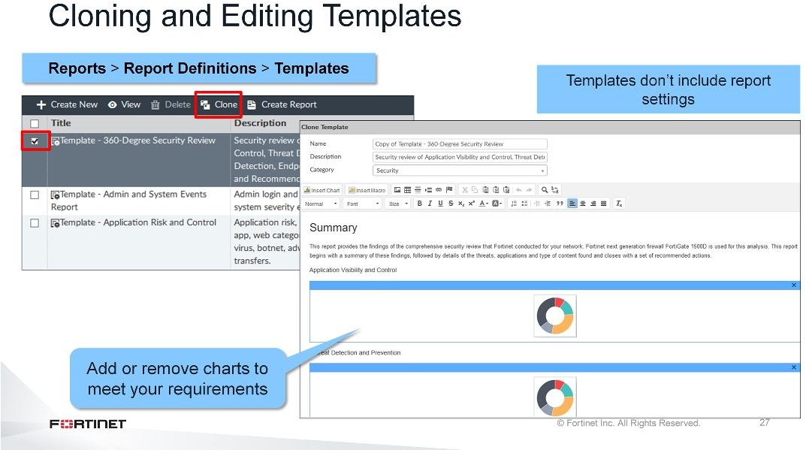
DO NOT REPRINT
© FORTINET
Reports
You can clone a template on theTemplatespage. Again, you should clone when you need to make only
minor to moderate changes. For example, when you want to borrow many of the elements, but not all, from an existing template. In the cloned template, you can edit only the layout.
Unlike predefined templates, you can delete cloned templates.

Slide 28
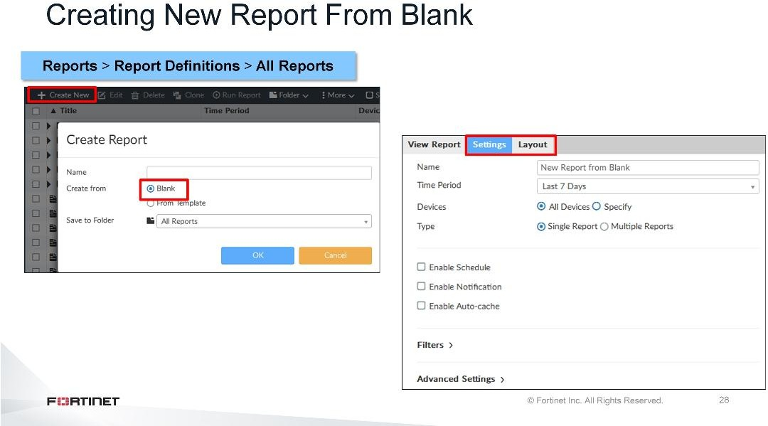
DO NOT REPRINT
© FORTINET
Reports
You can create a new report fromblankon theAll Reportspage. As shown in the graphic on this slide, you can configure both the settings and the layout. As it is a new report, both the settings and the layout are blank and you must configure them.
Once you create the layout, you do have the option to save it as a template. You can then use that template for other reports you create.
You can delete custom reports.

Slide 29
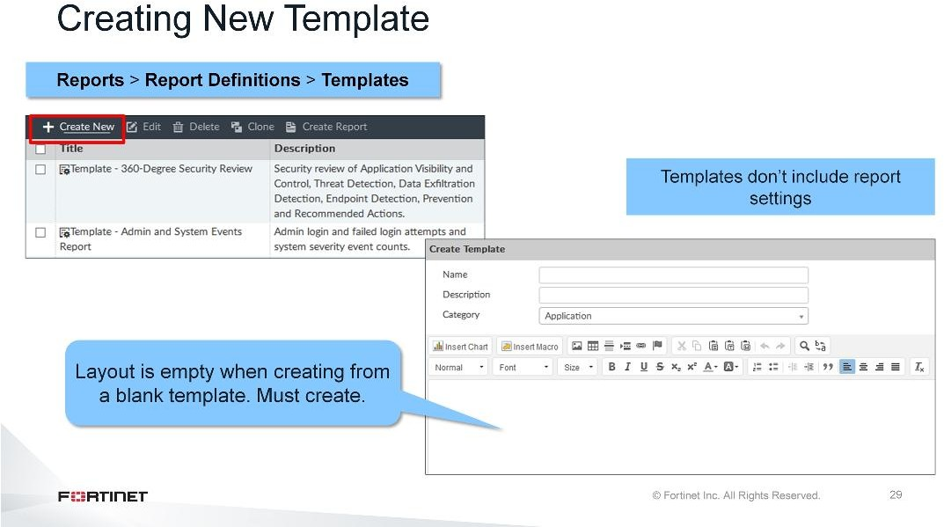
DO NOT REPRINT
© FORTINET
Reports
You can create a new template on theTemplatespage. The graphic shown on this slide shows that the Layouttab is blank. Use the layout toolbar on this page to build your layout. The toolbar allows you to insert existing charts and macros, and lets you add and format text, as well as add images and links.
After you create the layout, you can save it as a new custom template. You can then use that template in reports.
You can delete custom templates.

Slide 30
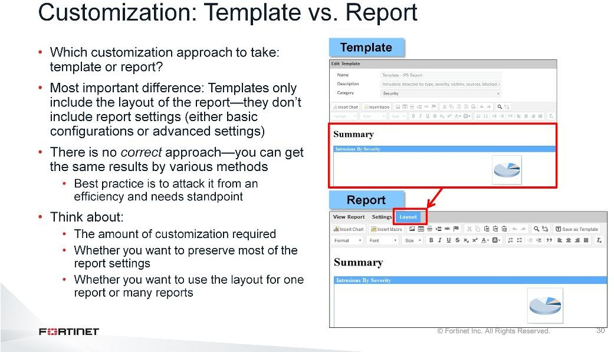
DO NOT REPRINT
© FORTINET
Reports
There is a close association between templates and reports. As discussed earlier, you can clone and edit both reports and templates, and you can create both new reports and templates. So how do you know which customization approach to take: do you attack the customization from the template side or report side?
One of the most vital differences between templates and reports is that templates include only the details you can find under theLayouttab of the report—they don’t include reports settings (either the basic configuration or advanced settings). So, when deciding whether to perform customizations on the template side or the report side, it depends on what you want to preserve and what you want to modify.
In the end, there is nocorrectapproach. You can achieve the same results through various methods. Best practice is to attack it from an efficiency and needs standpoint.

Slide 31
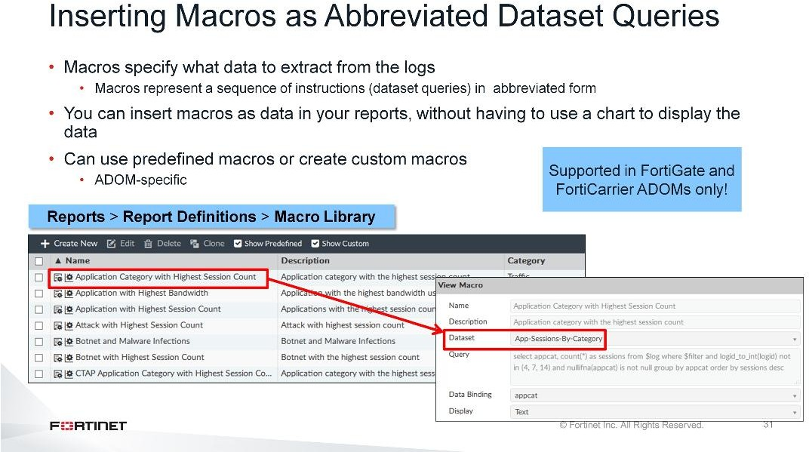
DO NOT REPRINT
© FORTINET
Reports
In FortiAnalyzer, macros specify what data to extract from the logs—they represent dataset queries in abbreviated form. You can insert macros as data in your reports, without having to use a chart to display the data. FortiAnalyzer provides predefined macros, or you can create your own custom macros.
Note that macros are ADOM-specific and supported in Fabric, FortiGate and FortiCarrier ADOMs only.

Slide 32
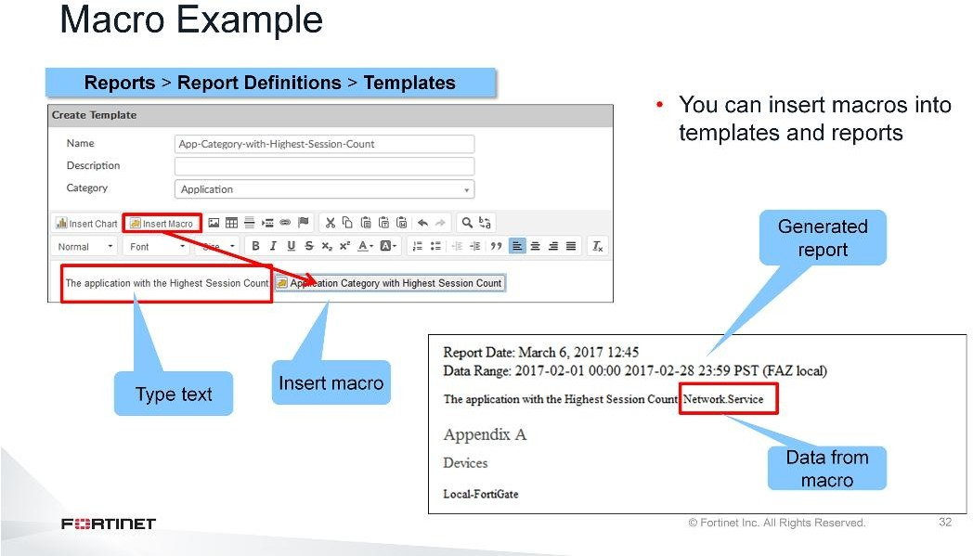
DO NOT REPRINT
© FORTINET
Reports
You can insert macros into custom templates, or into the layout of reports (either predefined or custom).
In the example shown on this slide, text is added before the inserted macro to give the macro some context. As you can see, when the report is generated, the data from the logs is extracted according to the query used in the macro. Here, the macroApplication Category with Highest CountreturnedNetwork.Servicefrom
the database.

Slide 33
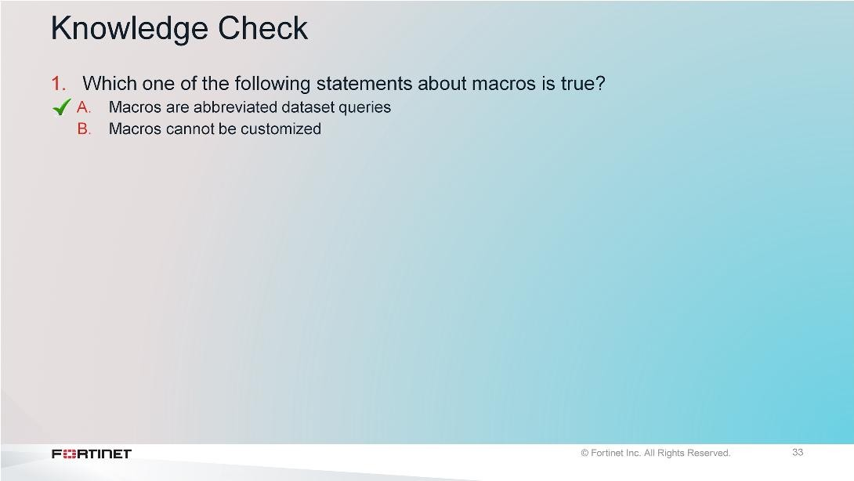
DO NOT REPRINT
© FORTINET
Reports

Slide 34

DO NOT REPRINT
© FORTINET
Reports
Good job! You now understand how to customize reports.
Now, you will learn how to customize charts and datasets.

Slide 35
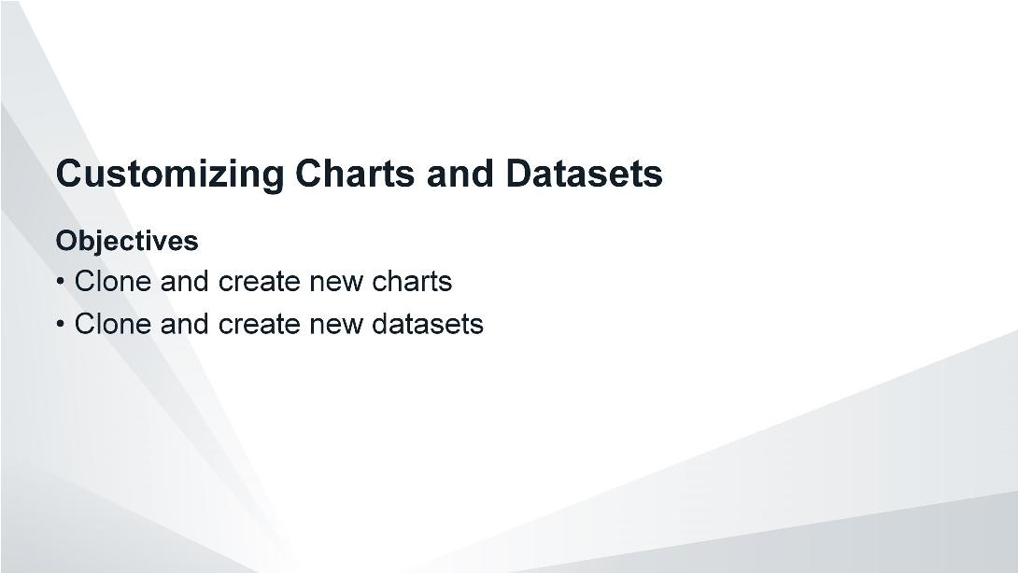
DO NOT REPRINT
© FORTINET
Reports
After completing this section, you should be able to achieve the objectives shown on this slide.
By demonstrating competence in chart and dataset customization, you will be able to extract unique combinations of data from the database specific to your requirements.

Slide 36
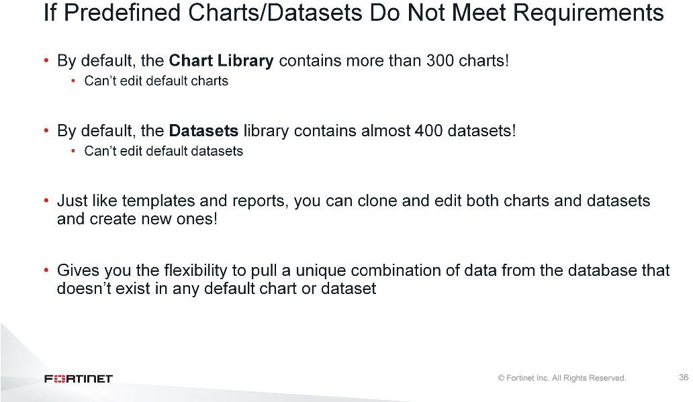
DO NOT REPRINT
© FORTINET
Reports
In some cases, simply adding or removing default charts from a report or template may not meet your requirements: you might need to pull a unique combination of data from the database when no predefined chart or dataset for that unique combination exists. In this case, you can either clone and edit charts and datasets, or create new charts and datasets from scratch.

Slide 37
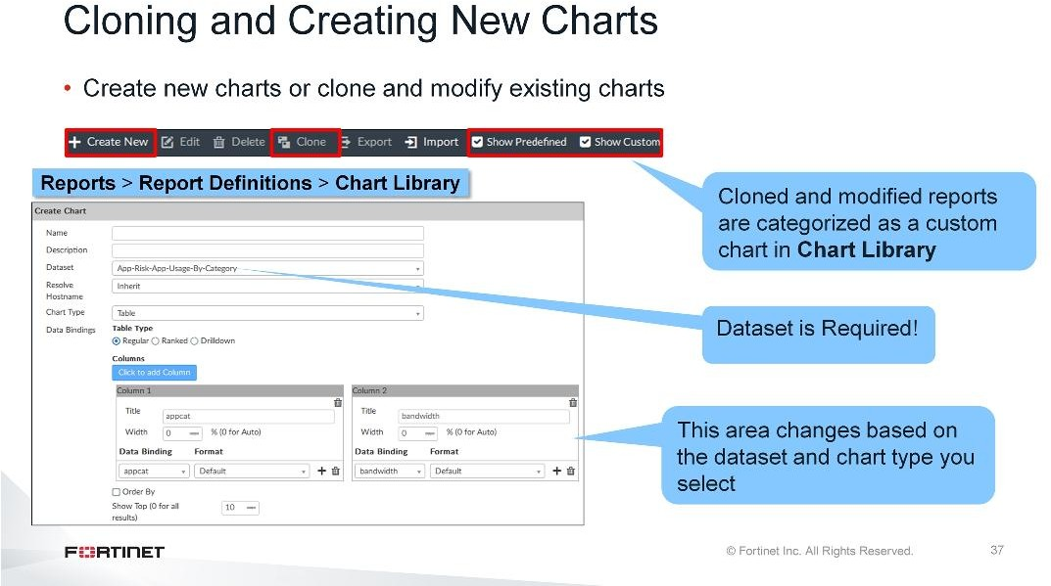
DO NOT REPRINT
© FORTINET
Reports
When creating a new chart, you first need a dataset that will query the database for the information you want. This is absolutely required. All a chart does is convert the text-based results of that query into a graphical format of your choosing (table, bar, pie, line, area donut).
After you select your dataset and chart type, the information in theData Bindingssection automatically adjusts based on those selections. Check theFortiAnalyzer Administration Guidefor more information on the data bindings option for your specific dataset and chart type.
If FortiAnalyzer includes an existing chart that is very similar to the output you want, you can clone and modify the chart rather than create a brand new one. A cloned chart is categorized as a custom chart, so remember to enableShow Customso that it appears in the chart library table for easy viewing or access.

Slide 38
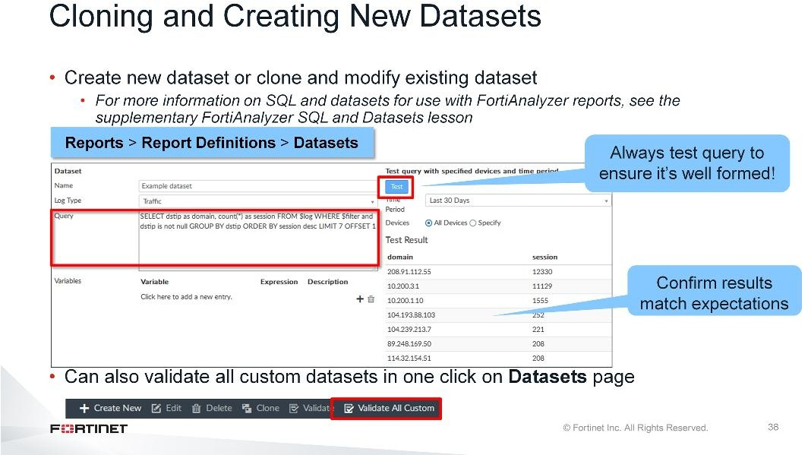
DO NOT REPRINT
© FORTINET
Reports
When creating a new dataset, you need to write an SQL SELECT query. For more information about writing queries, see theFortiAnalyzer SQL and Datasetslesson (supplemental training material).
Once you write the query, be sure to test it to ensure it’s well formed. Also, review the test results, and make sure it’s returning the data you expect.
If FortiAnalyzer includes an existing dataset that is very similar to what you want, you can clone and modify the dataset rather than create a brand new one.
Note that you can validate all custom datasets—which includes new and cloned datasets—in one click on the
Datasetspage. You should always validate your custom datasets after a firmware upgrade.

Slide 39
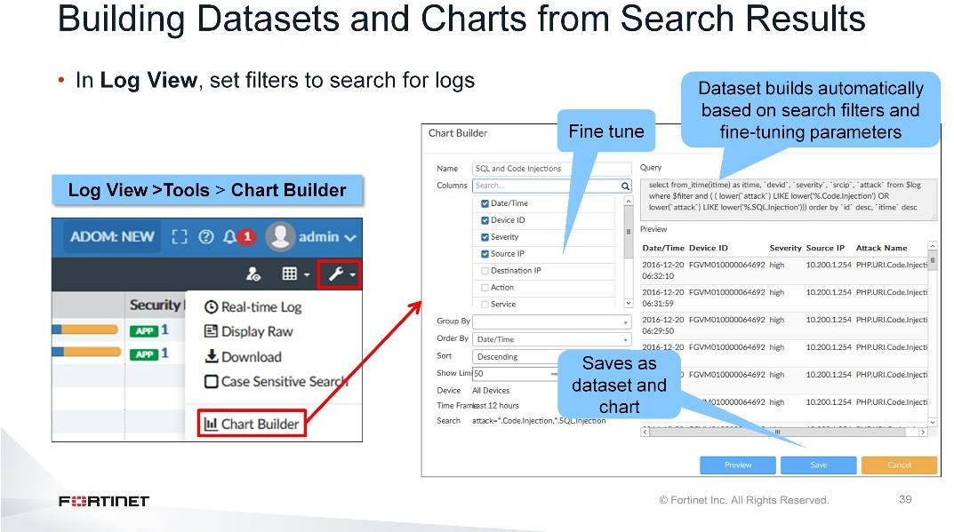
DO NOT REPRINT
© FORTINET
Reports
A quick way to build a custom dataset and chart is to use the chart builder tool. This tool is located inLog View, and allows you to build a dataset and chart automatically, based on your filtered search results. InLog View, set filters to return the logs you want. Then, in theToolsmenu, selectChart Builderto automatically build the search into a dataset and chart. You can also fine-tune the dataset further by:
Adding more columns
Setting a group, order by, and sort filter
Setting a limit on results
Setting the device and time frame.

Slide 40
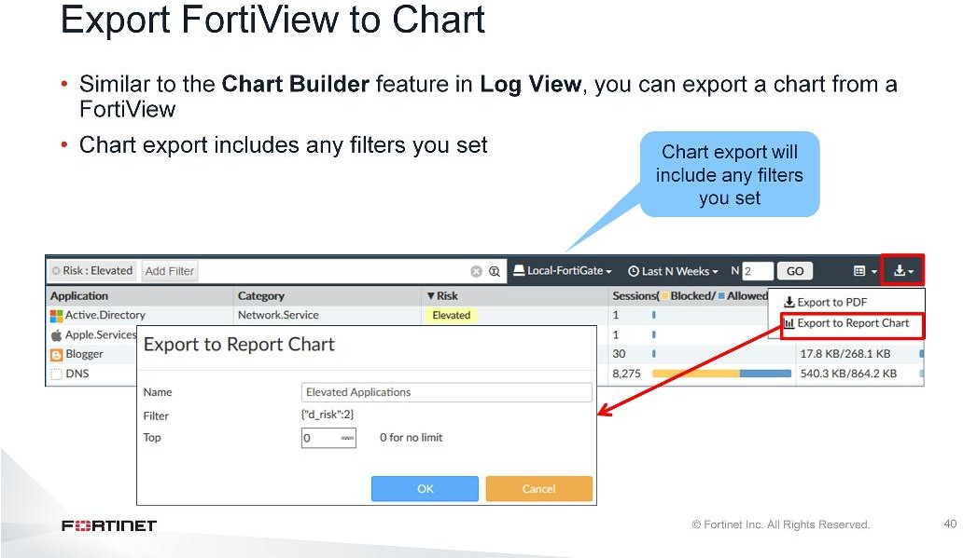
DO NOT REPRINT
© FORTINET
Reports
Similar to theChart Builderfeature inLog View, you can export a chart from a FortiView. The chart export includes any filters you set on the FortiView.

Slide 41
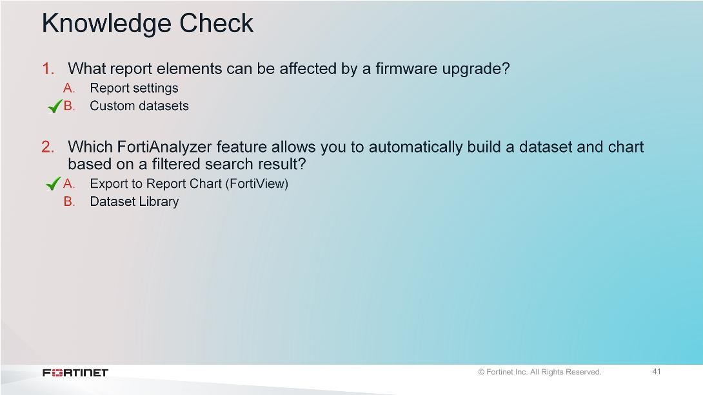
DO NOT REPRINT
© FORTINET
Reports

Slide 42
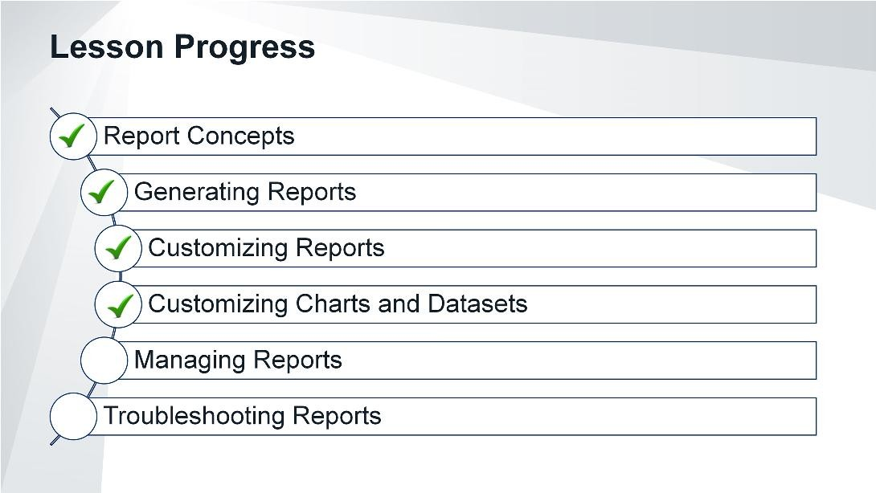
DO NOT REPRINT
© FORTINET
Reports
Good job! You now understand how to customize charts and datasets.
Now, you will learn how to manage reports.

Slide 43
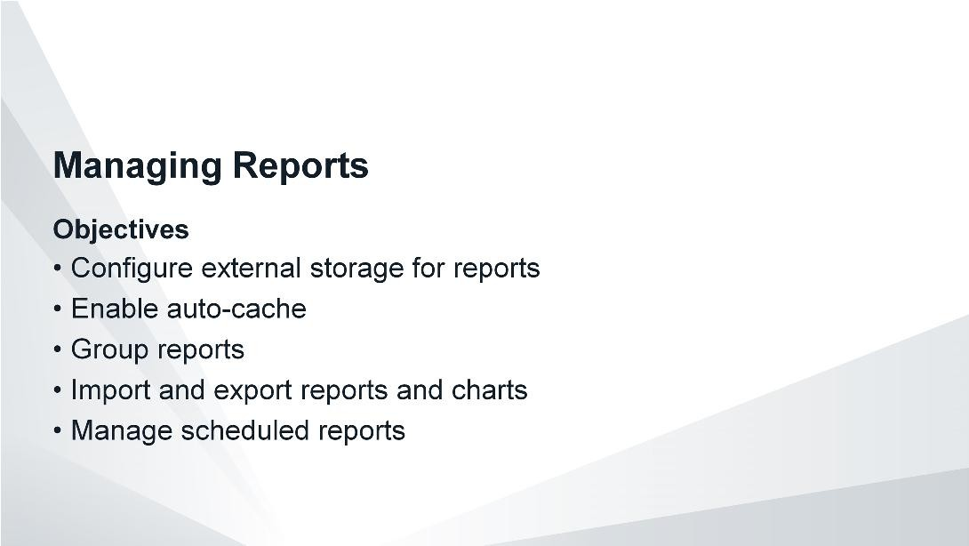
DO NOT REPRINT
© FORTINET
Reports
After completing this section, you should be able to achieve the objectives shown on this slide.
By demonstrating competence in report management, you will be able to handle, store, and more efficiently control reports and report generation.

Slide 44
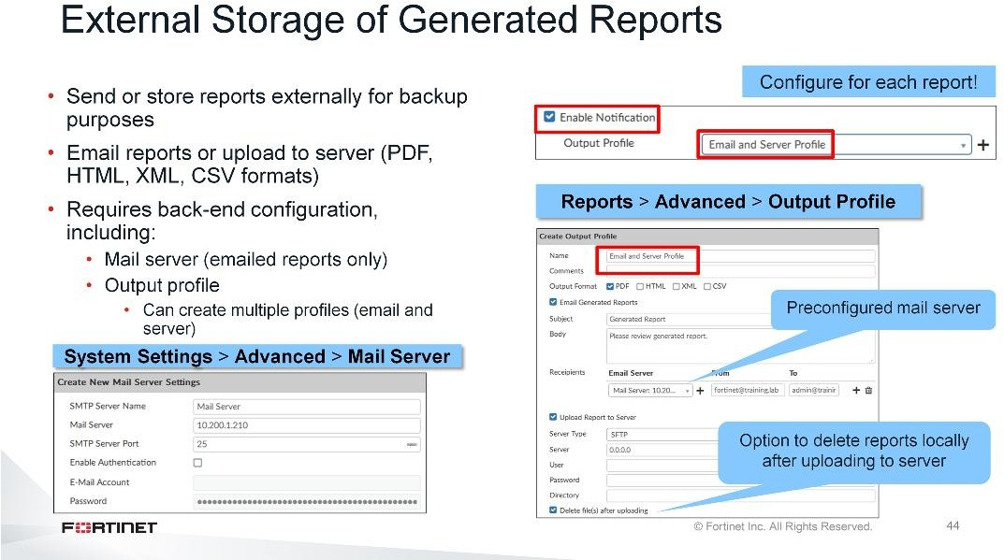
DO NOT REPRINT
© FORTINET
Reports
You can configure FortiAnalyzer to email generated reports to specific administrators, or to upload generated reports to a syslog server. This allows reports to exist externally, instead of remaining locally on FortiAnalyzer.
In order to use any of these external storage methods, you must first set up the back end. This includes configuring a mail server (for emailed reports only) and an output profile. If ADOMs are enabled, each ADOM has its own output profiles.
The output profile specifies the following:
The format of the report, such as PDF, HTML, XML, and CSV
Whether to email generated reports or upload to a server. You can specify one option or both, or create multiple outlook profiles. Server options include FTP, SFTP, and SCP.
Whether to delete the report locally after uploading to the server

Slide 45
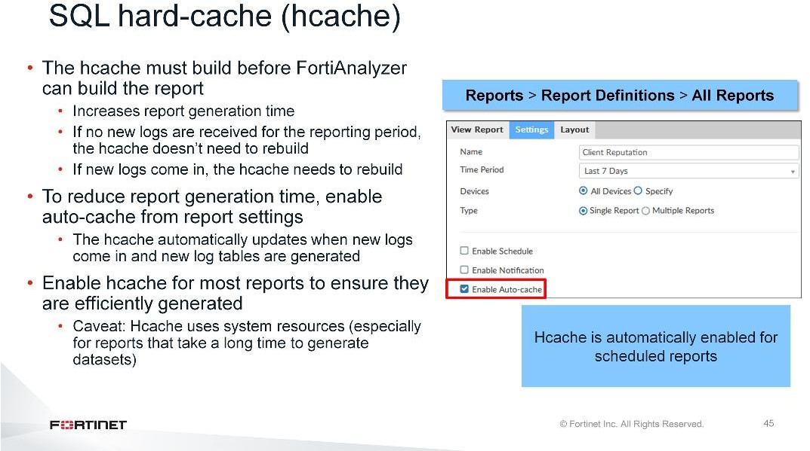
DO NOT REPRINT
© FORTINET
Reports
When a report generates, the system builds the charts from precompiled SQL hard-cache data, known as hcache. If the hcache is not built when you run the report, the system must create the hcache first and then build the report. This adds time to the report generation. However, if no new logs are received for the reporting period, when you run the report a second time it will be much faster, because the hcache data is already precompiled.
To boost the report performance and reduce report generation time, you can enable auto-cache in the settings of the report. In this case, the hcache is automatically updated when new logs come in and new log tables are generated.
Note that hcache is automatically enabled for scheduled reports. If you are not scheduling a report, you may want to consider enabling hcache. This ensures reports are efficiently generated. However, be aware that this process uses system resources (especially for reports that require a long time to assemble datasets), so you should monitor your system to ensure it can handle it.

Slide 46
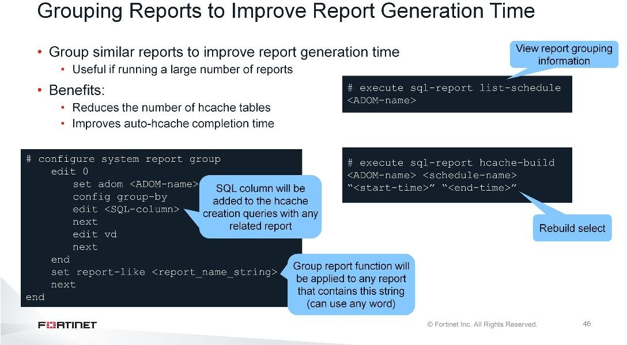
DO NOT REPRINT
© FORTINET
Reports
If the same (or similar) reports will be run against many different FortiGates, you can significantly improve report generation time by grouping the reports. Report grouping can reduce the number of hcache tables and improve auto-hcache completion time and report completion time.
After you configure report grouping using theconfigure system report groupCLI command, you must rebuild the report hcache tables. You can rebuild the hcache tables for those specific reports.

Slide 47
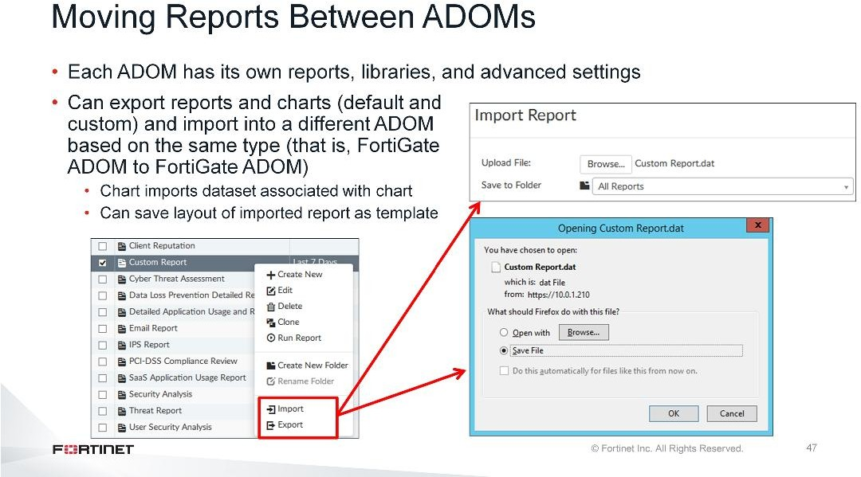
DO NOT REPRINT
© FORTINET
Reports
Remember, each ADOM has its own reports, libraries, and advanced settings. You can, however, import and export reports and charts (whether default or custom) into a different ADOM within the same FortiAnalyzer device or a different FortiAnalyzer device. The ADOM must be of the same type.
You can’t export templates and datasets. However, when you import an exported report, you can save the layout of the report as a template. When you export a chart, the associated dataset is silently exported with it, so when you import an exported chart, the associated dataset is imported as well.
You can export and import reports through the right-click menu on theReportspage. TheChart Libraryincludes the export and import functions in the toolbar.

Slide 48
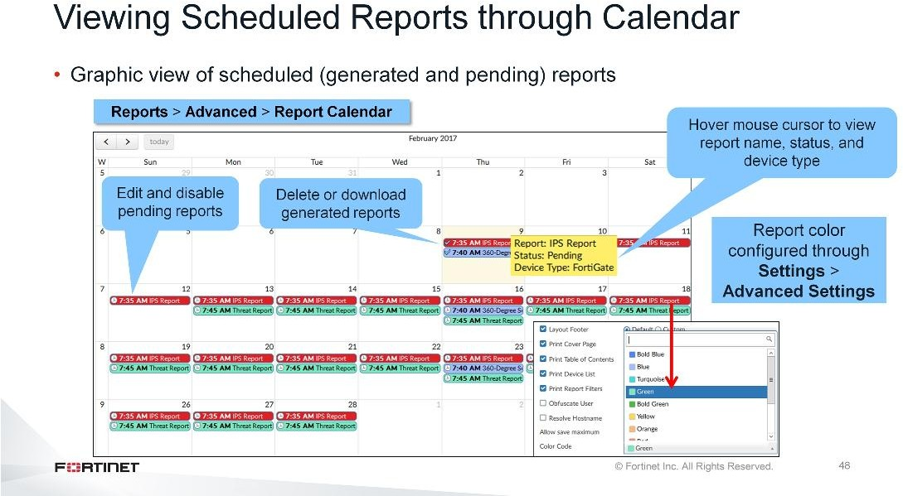
DO NOT REPRINT
© FORTINET
Reports
TheReport Calendarprovides an overview of all your scheduled reports. A check icon means the report has generated, while a clock icon means it is pending.
When you hover your mouse cursor over a scheduled report, a notification box appears that displays the report’s name, status, and device type.
You can edit and disable upcoming scheduled reports as well as delete or download completed reports by right-clicking the name of the report in the calendar.
Note that the scheduling is not actually done on this page, but configured in the specific report configuration itself.
You can also configure reports to display using a specific color in the report’sAdvanced Settingswindow.

Slide 49
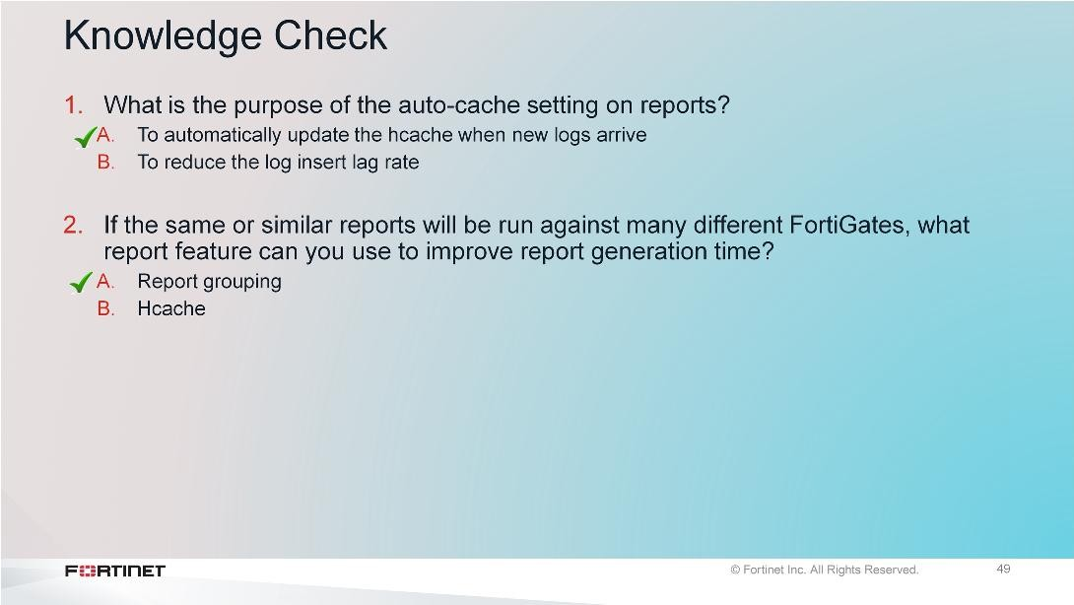
DO NOT REPRINT
© FORTINET
Reports

Slide 50

DO NOT REPRINT
© FORTINET
Reports
Good job! You now understand how to manage reports.
Now, you will learn about report troubleshooting.

Slide 51
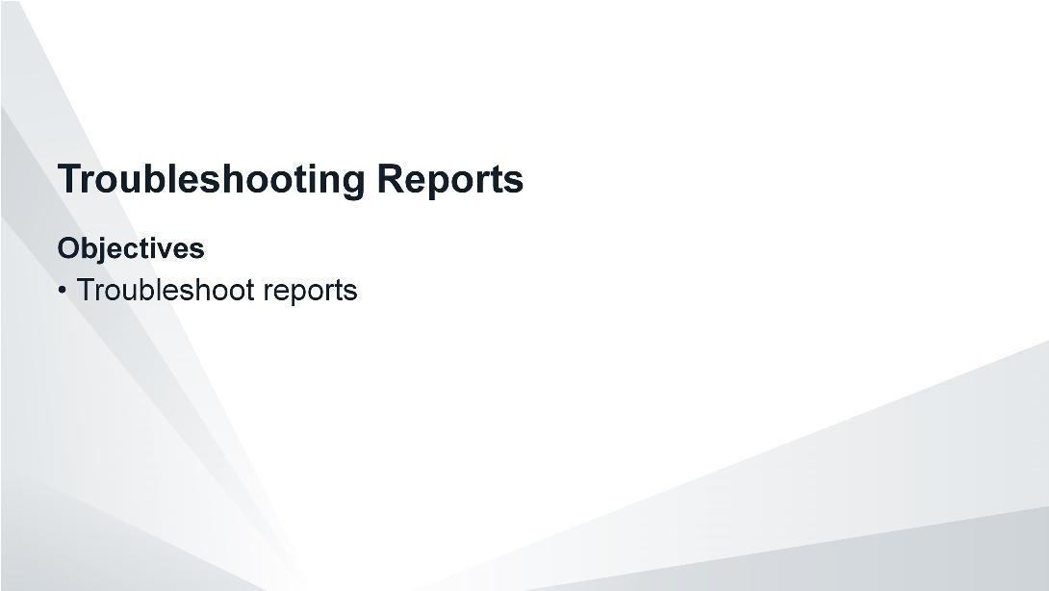
DO NOT REPRINT
© FORTINET
Reports
After completing this section, you should be able to achieve the objectives shown on this slide.
By demonstrating competence in report troubleshooting, you will be able to avoid, identify, and solve common reporting issues.

Slide 52
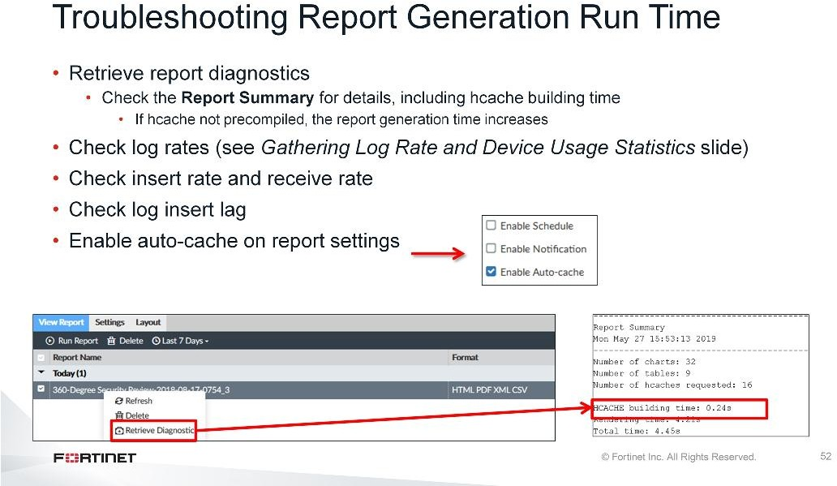
DO NOT REPRINT
© FORTINET
Reports
If your network has a high volume of devices sending logs to FortiAnalyzer as well as high log volume, reports can take some time to generate. If you find reports are taking too long to generate, there are a few steps you can take to troubleshoot:
Run diagnostics on your report and view the report summary at the end of the report. Look at the hcache time to see how long it took to build.
Check your log rates (as described earlier) to get an idea of log volumes
Check the insert rate, receive rate, and the log insert lag. They can tell you the rate at which raw logs are reaching the FortiAnalyzer (receive rate) and the rate at which they are indexed by the SQL database (insert rate) by the sqlplugind daemon. The log insert lag time tells you how many seconds the database is behind in processing the logs.
Enable auto-cache in the report settings to boost the reporting performance and reduce report generation time. Scheduled reports have auto-cache enabled already.

Slide 53

DO NOT REPRINT
© FORTINET
Reports
This slide shows some CLI commands you can use to troubleshoot issues related to report generation time.
Run# diagnose debug enableat the beginning to display the output.

Slide 54

DO NOT REPRINT
© FORTINET
Reports
What happens if you run reports and they are empty or don’t contain the desired information? Here are some troubleshooting tips:
Check the time frame that is covered by the report. This is listed within the report itself.
Compare the time frame to the logs and verify that you have the log file for the time in question
Verify that you have logs from the time the report was run and from the device that the report was run for. A common issue is caused by logs being overwritten too quickly. The result is that the logs needed for the report are overwritten and, as such, are unavailable once the report is run. In this case, the solution is to increase the disk quota to ensure that logs are retained longer.
Test the dataset in question and verify that it is retrieving the correct information. If it isn’t, then troubleshoot the SQL query itself, because it is probably the dataset that contains the error.
Check your report’s advanced settings. A setting such as user obfuscate can result in abnormal usernames in the report. Also verify the filters attached to a report. It is possible that your filter is filtering out the desired logs.

Slide 55

DO NOT REPRINT
© FORTINET
Reports

Slide 56

DO NOT REPRINT
© FORTINET
Reports
Congratulations! You have completed this lesson. Now, you will review the objectives that you covered in this lesson.

Slide 57

DO NOT REPRINT
© FORTINET
Reports
This slide shows the objectives that you covered in this lesson. By mastering the objectives covered in this lesson, you learned how to understand how data is formatted, stored, organized in the database and how to use the FortiAnalyzer reporting feature to view and extract useful information from logs.

Slide 58
DO NOT REPRINT
© FORTINET
Supplementary Material

Slide 59

DO NOT REPRINT
© FORTINET
SQL and Datasets
This supplemental material aims to provide an overview of SQL and datasets. While teaching SQL in its entirety is out of scope for FortiAnalyzer training, the goal is to provide you with enough information so you can modify or create datasets for the purpose of extracting data for reports.
No NSE 5 exam questions will be drawn specifically from this supplementary material.

Slide 60

DO NOT REPRINT
© FORTINET
SQL and Datasets
These are the topics we will explore in this lesson, beginning with datasets and SQL.

Slide 61

DO NOT REPRINT
© FORTINET
SQL and Datasets
This section covers datasets. Datasets define what data is extracted from the database and represented in a report’s chart.
While FortiAnalyzer does provide pre-defined datasets that address the most common queries, you need to understand Structured Query Language, also known as SQL, in order to modify those datasets or create your own.

Slide 62

DO NOT REPRINT
© FORTINET
SQL and Datasets
A dataset is an SQLSELECTquery. The result from that query—the specific data polled from the database— is what populates a chart.
FortiAnalyzer includes many predefined datasets that contain some of the most common database queries. These are available to view from theDatasetspage.
This is an example of the defaultTop-Destinations-By-Sessionsdataset.

Slide 63

DO NOT REPRINT
© FORTINET
SQL and Datasets
When you are building your queries, you must use SQL syntax to interface with the database. When creating or editing datasets, there is aTestbutton where you can test your query. If it is not formed correctly, an error message appears. If it formed correctly, and the data you are querying is available in the database, the results appear.
Note that SQL queries are not case-sensitive.

Slide 64

DO NOT REPRINT
© FORTINET
SQL and Datasets
Now let’s take a closer look at the query itself. In order to understand this example dataset, and more specifically, what it is querying, you need to understand SQL. SQL is what is known as a declarative language—it describeswhatneeds to be done rather then how to do it.
In an SQL database all information is represented as tables, each table consists of a set of rows and columns. There are two types of tables:
User tables, which contain information that is in the database, and
System tables, which contain the database description.

Slide 65

DO NOT REPRINT
© FORTINET
SQL and Datasets
In order to retrieve and manipulate data in the database, you need to use data manipulation language, which is a family of syntax elements used by SQL. These syntax elements are SELECT, INSERT, UPDATE, and DELETE. These are the first words used in a query—they are the declarative verbs describing what you want done.
As far as FortiAnalyzer reports are concerned, only the SELECT statement is used. It is purely a read-only query statement that is used to retrieve data from the database.

Slide 66

DO NOT REPRINT
© FORTINET
SQL and Datasets
The SELECT statement is used to query the database and retrieve log data. In order to pull the data you want, you must specify the criteria. For example, let’s say you want to query the database for a list of employees who work in the IT department. In order to put this criteria into a language that SQL understands, you must use a clause recognized by the SELECT statement.
The main clauses FortiAnalyzer reports use are:
FROM, which specifies the table.
WHERE, which specifies the conditions. All rows that do not satisfy the condition are eliminated from the output.
GROUP BY, which collects data across multiple records and groups the results by one or more columns.
ORDER BY, which orders the results by rows. If ORDER BY is not given, the rows are returned in whatever order the system finds the fastest to produce. And finally,
LIMIT, which limits the number of records returned based on a specified value. OFFSET is another clause often used along with LIMIT, which offset the results by the number specified. For example, if you place a limit of 3 records and an offset of 1, the first record that would normally be returned is skipped and instead the second, third, and fourth records (3 in total) are returned.
FROM is the only mandatory clause required to form a SELECT statement; the rest of the clauses are optional and serve to filter or limit, aggregate or combine, and control the sort. It is also important to note that the clauses must be coded in a specific sequence. This is to say that following the SELECT keyword, the statement must be followed by one or more clauses in the order they appear in this table provided. For example, you cannot use the WHERE clause before the FROM clause. You do not have to use all optional clauses, but whichever ones you do use they have to be in the correct sequence.

Slide 67

DO NOT REPRINT
© FORTINET
SQL and Datasets
SELECT is the first word used in any SQL query that involves FortiAnalyzer reports. This is a declarative statement that instructs the program to query the column in the database for the information you want returned. For example:
SELECT dstip
Dstip is the column name for destination IP in the SQL schema. Note that you can select more than one column name and you can also have the column name appear under a more user friendly name in the results table by appending the command with “as <friendly_name_of_column>. For example,SELECT dstip as destination_ip. In the results table, the values for dstip will now appear under a column named destination_ip.
If you want to return all data, you can use the*symbol. For example,SELECT *. Though most of the time that is more information that you require.
At minimum, you must use the FROM clause with your SELECT statement. This instructs the program where the information is located.
For example:
FROM $log
Here $log refers to the logs in the log type selected for the dataset, such as traffic logs or web filter logs to name a few.

Slide 68

DO NOT REPRINT
© FORTINET
SQL and Datasets
You can search multiple log types in order to combine the data so that you can compare and contrast information. To do this, use the log type syntax associated with the specific log type. For example, if you want to search both the traffic logs and web filter logs, use:
FROM $log-traffic, $log-webfilter

Slide 69

DO NOT REPRINT
© FORTINET
SQL and Datasets
Out of all the optional clauses, the WHERE statement is really the heart of the query, because this is where you specify the criteria.
The WHERE statement must always come after the FROM statement.
In this example, the first expression is$filter, which is used to restrict the results to the time period you select. While the time period is not added to the query itself, it is specified by way of a drop-down box when creating the dataset through the FortiAnalyzer GUI.
The second expression isdstip, which is the destination IP, while the third expression is NULL.
SQL supports logic operators as well, so you can use AND/OR/NOT statements in order to build out the query. Operators will be discussed later in this lesson.

Slide 70

DO NOT REPRINT
© FORTINET
SQL and Datasets
The GROUP BY clause is used to create one output row for each group. It is usually used with an aggregate function within the SELECT statement. We will cover aggregate functions later, but essentially they perform a calculation on a set of values and return a single value. If it is not used with an aggregate function, it is similar to the DISTINCT clause, in that it removes duplicates from the result set of a SELECT statement.
In this example, the GROUP BY clause is use with an aggregate function. The aggregate function is
count(*), which selects all rows in a table, even if some columns contain a NULL value.
In this example, we are grouping bydstip(destination IP).

Slide 71

DO NOT REPRINT
© FORTINET
SQL and Datasets
ORDER BY is a clause that allows you to sort queries by column name or column number. By default, rows of an SQL query result table are not arranged in a particular order, so you can use the ORDER BY clause to sort column values in either ascending (asc) or descending (desc) order. If you use this clause and do not specify ascending or descending, the default is ascending.
You can order multiple columns and specify different sort orders for each. For example, you can sort one column in ascending order and another column in descending order.
In this example, we are ordering by session in descending order.

Slide 72

DO NOT REPRINT
© FORTINET
SQL and Datasets
By default, all results that satisfy the conditions specified in the query are returned. However, if you only want to retrieve a subset of records, you can place a limit on the records returned. To do this, use the LIMIT clause and specify the number of results you want. For example,LIMIT 7. This is a great way of making sure that the query doesn’t use unnecessary CPU or memory, especially if you have a large scale deployment with lots of devices logging to the FortiAnalyzer. You can also combine LIMIT with ORDER BY asc to get the “top <x> results” (or desc for the “bottom <x> results”).
In conjunction with the LIMIT clause you can use the OFFSET clause. This offsets the results by a set value. For example, if you place a limit of 7 records and an offset of 1, the first record that would normally be returned is skipped and instead 2 through 8 are returned.

Slide 73

DO NOT REPRINT
© FORTINET
SQL and Datasets
As we’ve been introducing and explaining the main SQL clauses, we’ve been forming a full dataset query along the way. To visually see how it all ties together, we can use the datasetTestfeature in the GUI. The feature is intended to test or modify a query in order to get the specific output you want.
Ensure you select the log type for the query. The query uses the generic$log, but it references the log type specified in theLog Typedrop-down field (in this example, Traffic). You can enter the specific log type in the query instead (for example,$log-traffic), but should you want to view this query on a different log type later, it’s less risky and easier to change from theLog Typedrop-down field than in the actual dataset query itself.
On the right side of the dialog box, you must also specify the device or devices on which to use this query. Here, we have specifiedAll Devices.
You must also specify a time period for this query. As mentioned earlier, the$filterexpression used with our WHERE clause states that we want to limit the results to the time period we specify. TheTime Period drop-down box is where we specify this time period.
If there is an error in the query, the error message appears in the window below. If the query is correct, the results appear in the window below. Since the results appear in the window below, we know our dataset has been correctly formed.

Slide 74

DO NOT REPRINT
© FORTINET
SQL and Datasets
Now let’s align the written query with the visual results to fully understand how the query is interpreted by FortiAnalyzer.
SELECT dstip as destination_ip, count(*) as session: This says, select the destination IP address and call the column “destination_ip”. Select the count (all data) and call the column “session”.
FROM $log: This says, query the traffic log for the data, which is specified in theLog Typedrop-down list.
WHERE $filter and dstip is not null: This says, limit the results to the time period specified, which isTodayaccording to the selection in theTime Perioddrop-down list, and only provide destination IP addresses that are not null. Note that “null” represents unknown data—it does not represent zero.
GROUP BY dstip: This says, group the results by destination IP. Remember, we specified we wanted dstip put in a column called “destination_ip”.
ORDER BY session desc: This says, order the results by session in descending order. Note that the results go from high (200) to low (4).
LIMIT 7: This says, only provide the first seven results.
OFFSET 1: This says, skip the first result, but still limit the results to the next 7 (i.e. 2 through 8).

Slide 75

DO NOT REPRINT
© FORTINET
SQL and Datasets
Good job! You now understand datasets and SQL.
Now, let’s examine SQL functions and operators.

Slide 76

DO NOT REPRINT
© FORTINET
SQL and Datasets
This section covers a few of the most common functions and operators used in FortiAnalyzer datasets—it is not intended as a complete and exhaustive list.

Slide 77

DO NOT REPRINT
© FORTINET
SQL and Datasets
SQL has two types of functions: “normal” functions and aggregate functions.
Aggregate functions use the entire column of data as their input and produce a single output, while the “normal” functions operate on each element in the column of data.

Slide 78

DO NOT REPRINT
© FORTINET
SQL and Datasets
One common function used in FortiAnalyzer datasets is NULLIF. The NULLIF function takes two arguments. If the first two arguments are equal, then NULL is returned. Otherwise, the first argument is returned. Note that NULL represents unknown data—it does not represent zero.

Slide 79

DO NOT REPRINT
© FORTINET
SQL and Datasets
Another common function used in FortiAnalyzer datasets is COALSECE. The COALESCE function returns the first non-NULL expression among its arguments. Null is returned only if all arguments are null. It is often used to substitute a default value for null values when data is retrieved for display.
COALESCE is used with the SELECT statement. It takes one or more expressions as an argument. The values do not have to be string data types—they can be any data type (and also different data types). The syntax is:
COALESCE (expression 1, expression 2, …)

Slide 80

DO NOT REPRINT
© FORTINET
SQL and Datasets
Aggregate functions are a special category with different rules, as they operate on entire columns of data instead of discrete values. These functions perform a calculation on a set of values in a column and returns a single value. Although aggregate functions are usually used in conjunction with the GROUP BY clause, these functions can be used on their own in a SELECT statement.
This table includes a list of aggregate functions used in SQL. All can take an expression as an argument and ignore null values, except for count. Count can take an asterisk as an argument. The asterisk in this case means all rows are returned, even if some columns contain a NULL value.
An example of an expression used with an aggregate function isSELECT count(unauthuser). This would return the number of unauthorized users.

Slide 81

DO NOT REPRINT
© FORTINET
SQL and Datasets
Now let’s take a look at SQL operators. An operator is a reserved word or a character used primarily in an SQL statement's WHERE clause to perform various operations.
There are three types of operators:
Arithmetic operators
Comparison operators
Logical operators

Slide 82

DO NOT REPRINT
© FORTINET
SQL and Datasets
Here are some examples of arithmetic operators. Arithmetic operators perform mathematical operations on two expressions of one or more of the data types of the numeric data type category.

Slide 83

DO NOT REPRINT
© FORTINET
SQL and Datasets
Here are some examples of comparison operators. Comparison operators test whether two expressions are the same and can be used on all expressions except expressions of thetext,ntext, orimagedata types.

Slide 84

DO NOT REPRINT
© FORTINET
SQL and Datasets
Here are some examples of logical operators. Logical operators test for the truth of some condition. Like comparison operators, they return a Boolean data type with a value of TRUE, FALSE, or UNKNOWN.

Slide 85

DO NOT REPRINT
© FORTINET
SQL and Datasets
Good job! You now understand SQL functions and operators.
Now, let’s examine FortiAnalyzer functions and macros.

Slide 86

DO NOT REPRINT
© FORTINET
SQL and Datasets
This section covers FortiAnalyzer functions and macros.
FortiAnalyzer includes some built-in functions that are based on known SQL functions, but scripted differently.
FortiAnalyzer also includes macros, which are best described as lengthy or complex SQL statements scripted more simplistically. An SQL macro can be used anywhere in a query where an ordinary SQL expression can be used.

Slide 87

DO NOT REPRINT
© FORTINET
SQL and Datasets
One FortiAnalyzer-specific function is root_domain(hostname). This provides the root domain of the fully qualified domain name. As per the query, in this example root_domain(hostname) is listed under thewebsite column in ascending order (the default for the ORDER BY clause if not specified).

Slide 88

DO NOT REPRINT
© FORTINET
SQL and Datasets
Another FortiAnalyzer-specific function is nullifna, which takes an expression as an argument. The actual SQL syntax this is based on is SELECT NULLIF(NULLIF(expression, 'N/A'), 'n/a').
In this example, if the user is n/a the source IP is displayed, otherwise it returns the user name. It performs the inverse operation of the COALESCE function. As you can see in theuser_srccolumn, there are some IP address and some user names.

Slide 89

DO NOT REPRINT
© FORTINET
SQL and Datasets
email_domain and email_user are other FortiAnalyzer-specific functions. email_domain retrieves anything that is after the @ symbol in an email address—the domain. email_user retrieves anything that is before the @ symbol in an email address.
As per the query, in this example email_user displays in the columne_user, while email_domain displays in the columne_domain.

Slide 90

DO NOT REPRINT
© FORTINET
SQL and Datasets
from_dtime and from_itime are other FortiAnalyzer-specific functions. from_dtime returns the device timestamp without the time zone, while from_itime returns FortiAnalyzer’s timestamp without the time zone.
As per this query, from_itime appears in the columnfaz_local_time, while from_dtime appears in the column
dev_local_time.

Slide 91

DO NOT REPRINT
© FORTINET
SQL and Datasets
Here are some common date and time macros used in FortiAnalyzer. Macros are simple substitutions for more complex SQL statements—usually created for SQL statements that are frequently used.

Slide 92

DO NOT REPRINT
© FORTINET
SQL and Datasets
Congratulations! You have completed this lesson.

Slide 93



DO NOT REPRINT
© FORTINET
No part of this publication may be reproduced in any form or by any means or used to make any derivative such as translation, transformation, or adaptation without permission from Fortinet Inc., as stipulated by the United States Copyright Act of 1976.
Copyright© 2019 Fortinet, Inc. All rights reserved. Fortinet®, FortiGate®, FortiCare® and FortiGuard®, and certain other marks are registered trademarks of Fortinet, Inc., in the U.S. and other jurisdictions, and other Fortinet names herein may also be registered and/or common law trademarks of Fortinet. All other product or company names may be trademarks of their respective owners. Performance and other metrics contained herein were attained in internal lab tests under ideal conditions, and actual performance and other results may vary. Network variables, different network environments and other conditions may affect performance results. Nothing herein represents any binding commitment by Fortinet, and Fortinet disclaims all warranties, whether express or implied, except to the extent Fortinet enters a binding written contract, signed by Fortinet’s General Counsel, with a purchaser that expressly warrants that the identified product will perform according to certain expressly-identified performance metrics and, in such event, only the specific performance metrics expressly identified in such binding written contract shall be binding on Fortinet. For absolute clarity, any such warranty will be limited to performance in the same ideal conditions as in Fortinet’s internal lab tests. In no event does Fortinet make any commitment related to future deliverables, features, or development, and circumstances may change such that any forward-looking statements herein are not accurate. Fortinet disclaims in full any covenants, representations,and guarantees pursuant hereto, whether express or implied. Fortinet reserves the right to change, modify, transfer, or otherwise revise this publication without notice, and the most current version of the publication shall be applicable.

